Slide 1
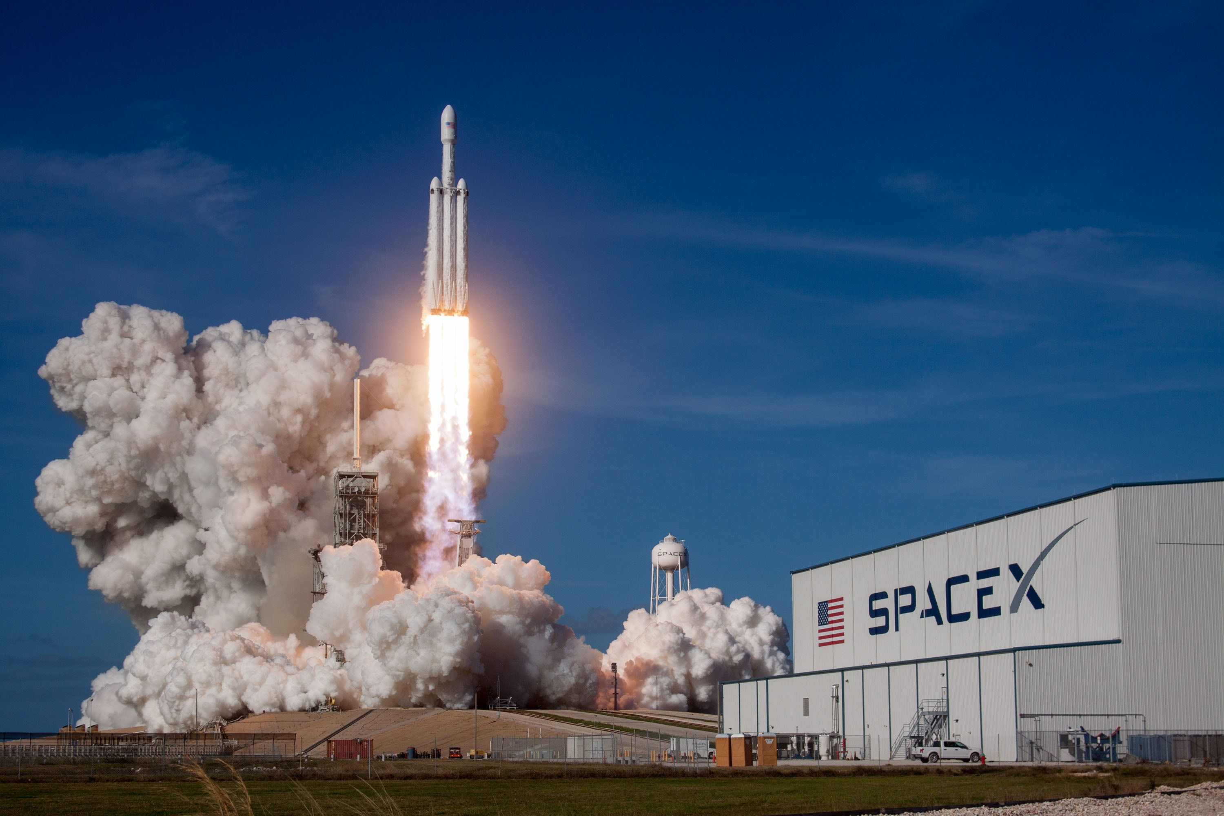
SPACE X FALCON 9 Analysis
Nasmane Abdelhadi
23th August 2023

Slide 2
Table Of Content
Executive Summary
Introduction
Methodology
Results
Conclusion
Appendix

Slide 3
Executive Summary
Methodologies
Data Collection
Data Wrangling
EDA with SQL & Data Visualization
Interactive Visual Analytics with Folium and Plotly/Dash
Machine Learning Prediction
Results
EDA results
Interactive Analytics results
Predictive Analytics results

Slide 4
Introduction
Context
SpaceX advertises Falcon 9 rocket launches on its website with a cost of 62 million dollars; other providers cost upward of 165 million dollars each, much of the savings is because SpaceX can reuse the first stage. Therefore if we can determine if the first stage will land, we can determine the cost of a launch. This information can be used if an alternate company wants to bid against SpaceX for a rocket launch.
Main Question
Can We determine whether a rocket will land successfully or not?

Slide 5
Methodology
Data collection methodology (Through API and Web Scraping)
Data wrangling (One Hot Encoding)
EDA using visualization and SQL
Interactive visual analytics using Folium and Plotly Dash
Predictive analysis using classification models

Slide 6
Data Collection
The data was collected using various methods
Data collection was done using get-request to the SpaceX API.
Cleaning the data, checking for missing values and filling in missing values where necessary.
Web scraping from Wikipedia for Falcon 9 launch records with BeautifulSoup.
SpaceX API
Web Scraping
Get-request to the SpaceX API to collect data
Cleaning the requested data and doing some basic data wrangling and formatting.
Web scraping to Wikipedia Falcon 9 launch records with BeautifulSoup
Parsing the table and converting it into a pandas DataFrame.

Slide 7
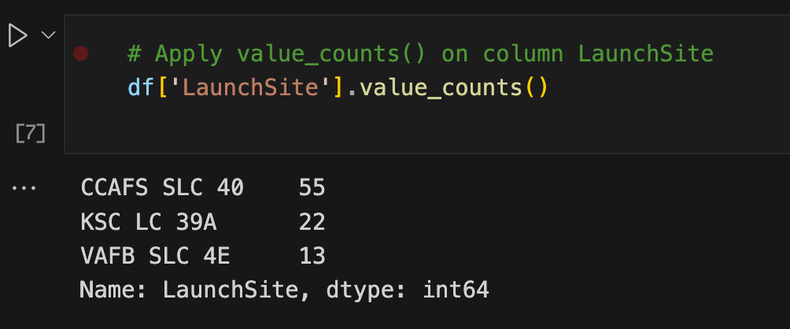
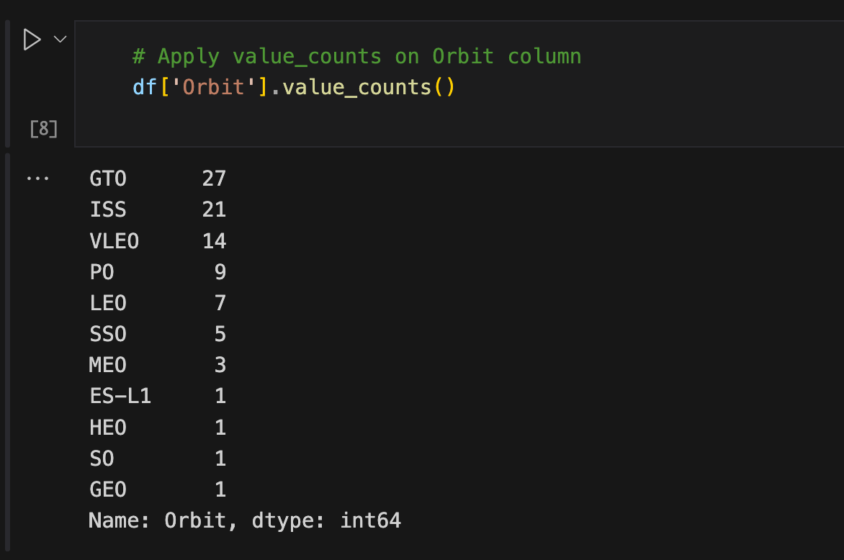
Data Wrangling
Performing EDA and determined the training labels.
Calculating number of launches at each site, and the number and occurrence of each orbits

Slide 8
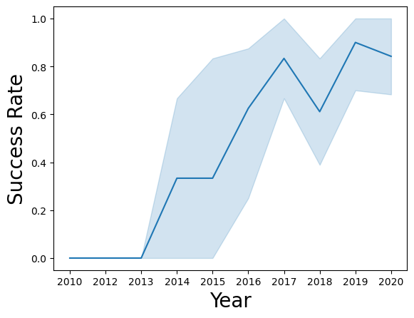
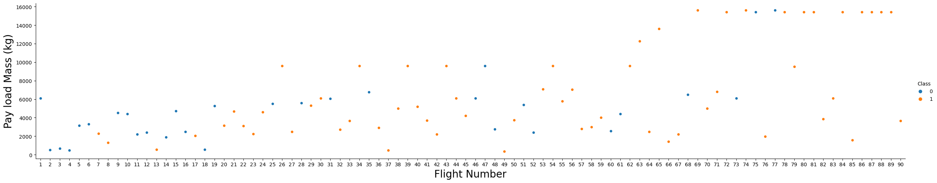
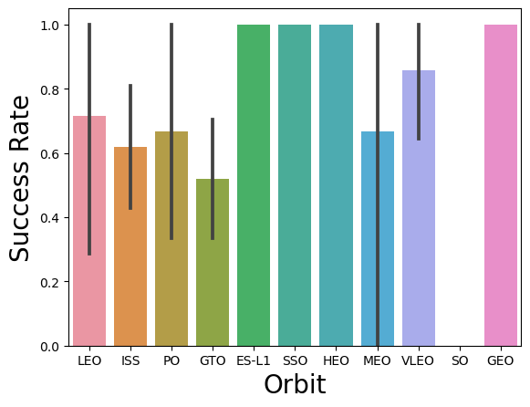
EDA with Data Vizualization
Highlighting the relationship between flight number and launch Site, payload and launch site, success rate of each orbit type, flight number and orbit type, the launch success yearly trend.

Slide 9
EDA with SQL
Some Queries
The names of unique launch sites in the space mission.
The total payload mass carried by boosters launched by NASA (CRS)
The average payload mass carried by booster version F9 v1.1
The total number of successful and failure mission outcomes
The failed landing outcomes in drone ship, their booster version and launch site names.

Slide 10
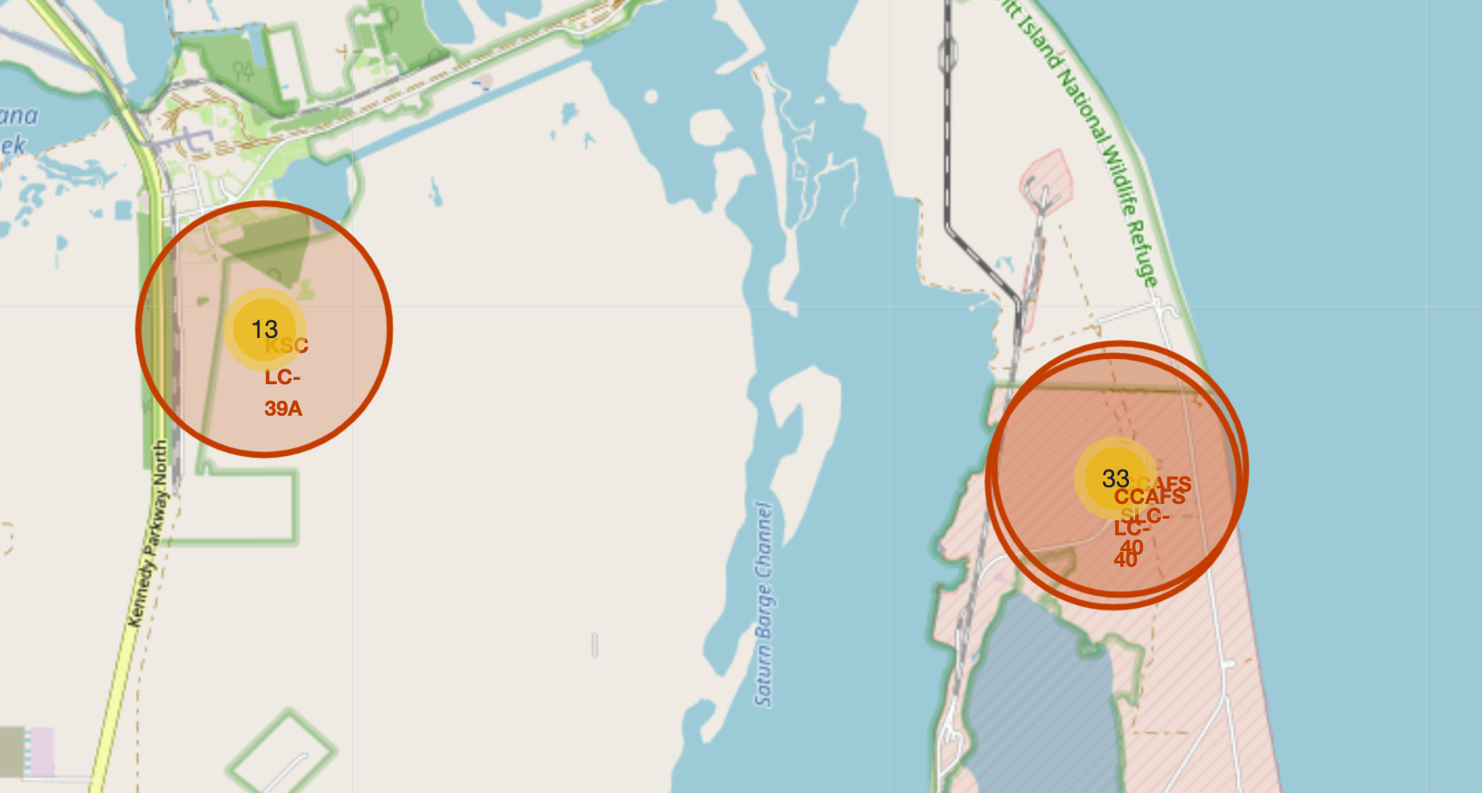
Interactive Map Using Folium
Marking all launch sites, and adding map objects to highlight the success or failure of launches for each site on the folium map.
Assigning the feature launch outcomes to class 0 and 1.
Using the color-labeled marker clusters, and identifying which launch sites have relatively high success rate.

Slide 11
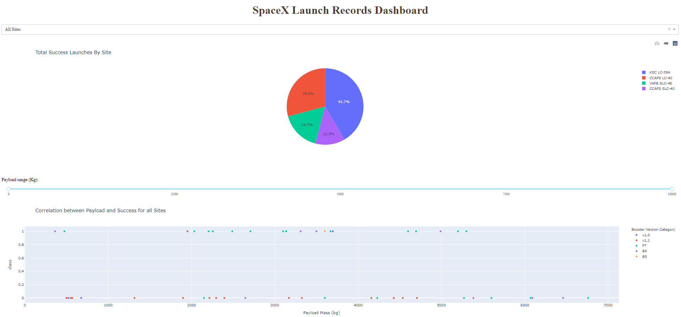
Building a Dashboard
Building an interactive dashboard with Plotly dash
Plotting pie charts showing the total launches by a certain sites
Plotting scatter graph showing the relationship with Outcome and Payload Mass (Kg) for the different booster version.

Slide 12

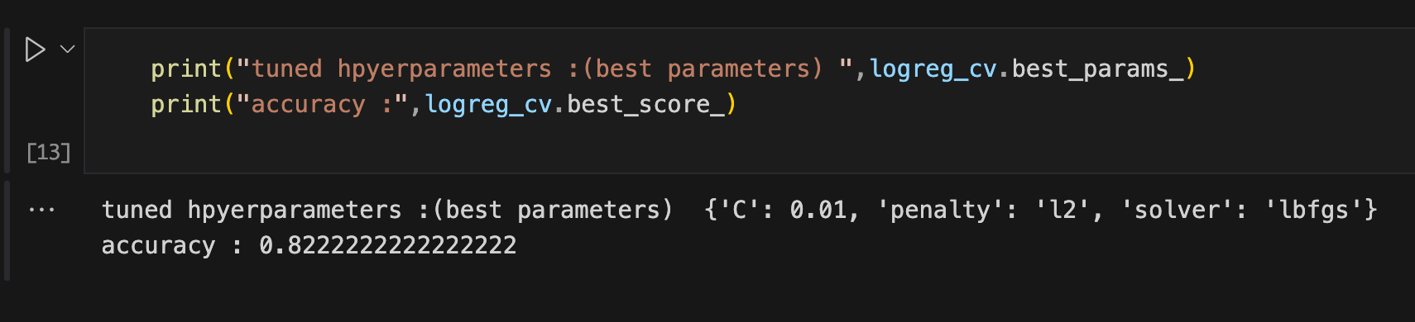
Predictive Analysis
Splitting Data into Training/Testing parts
Building different machine learning models and tune different hyperparameters using GridSearchCV.
Using R2 score to select the best model.

Slide 13
Results
EDA results
Interactive Analytics results
Predictive Analytics results

Slide 14
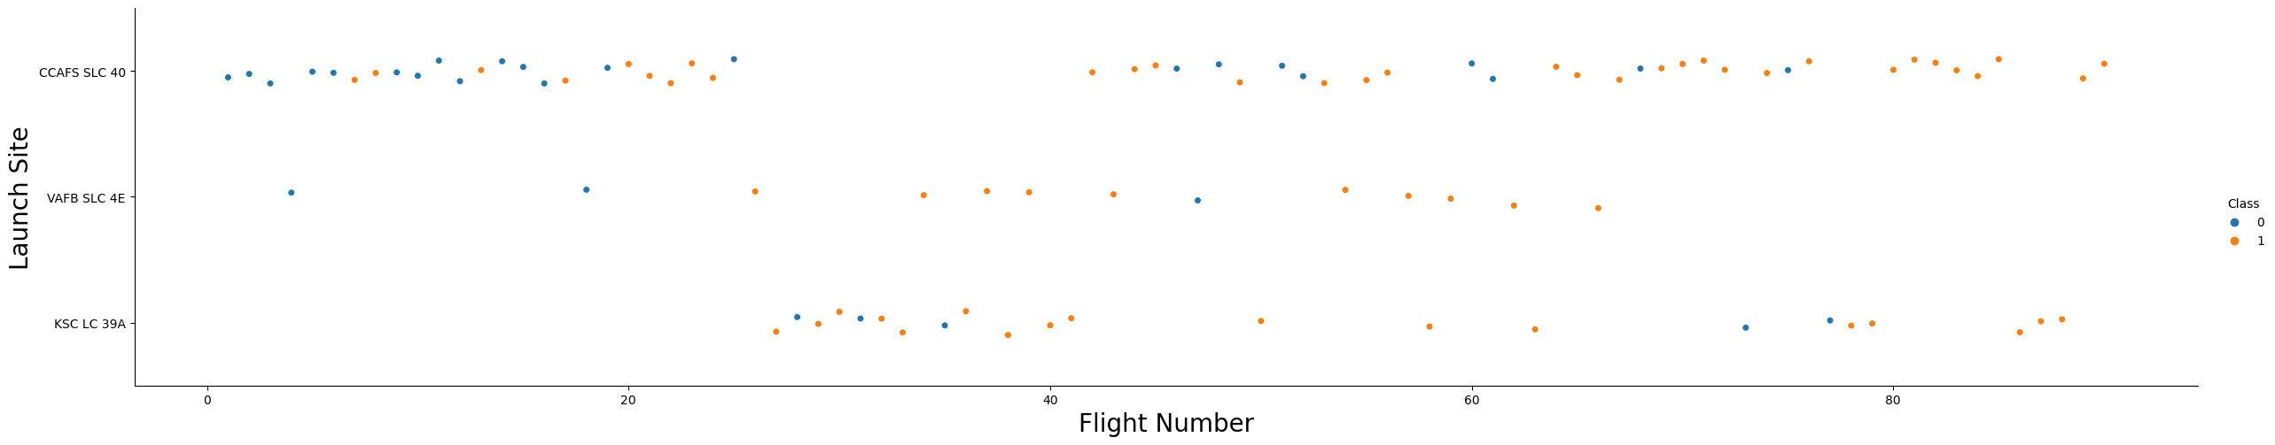
Flight Number vs Launch Site
We can see how each launch Site has done well recently because of the experience gained from flights

Slide 15
Flight Number vs Payload Mass
The higher the Payload Mass, the higher the success rate.

Slide 16
Success Rate per Orbit
SSO, HEO, ES-L1, GEO has the highest Success Rate

Slide 17
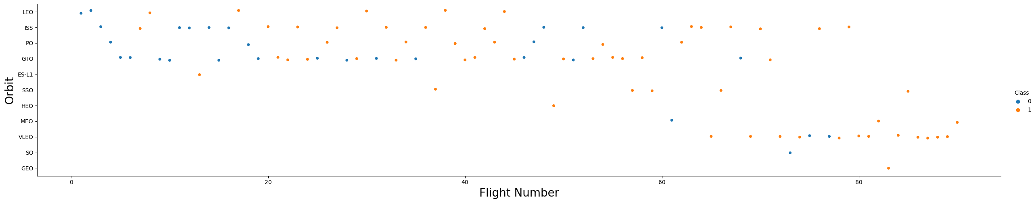
Flight Number for each Orbit
All flights of SSO, HEO, ES-L1, GEO were Successful

Slide 18
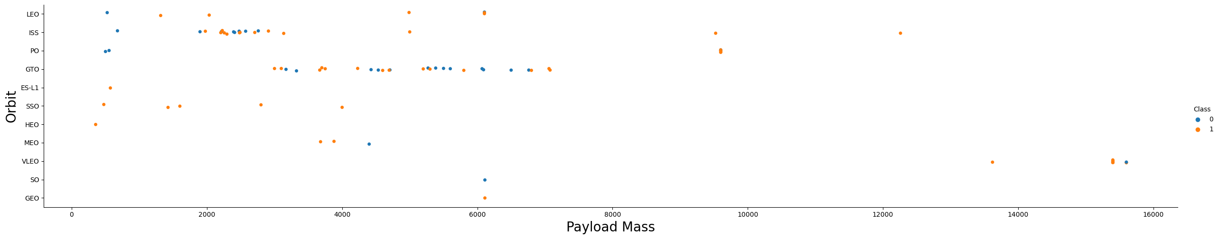
Payload Mass used for each Orbit
Even if the payload mass for SSO orbit is low, the flights were successful, also the higher the payload mass the higher the success rate

Slide 19
Launch Success Rate during the Years
The Success Rate is increasing over the years due to the experience gained.

Slide 20
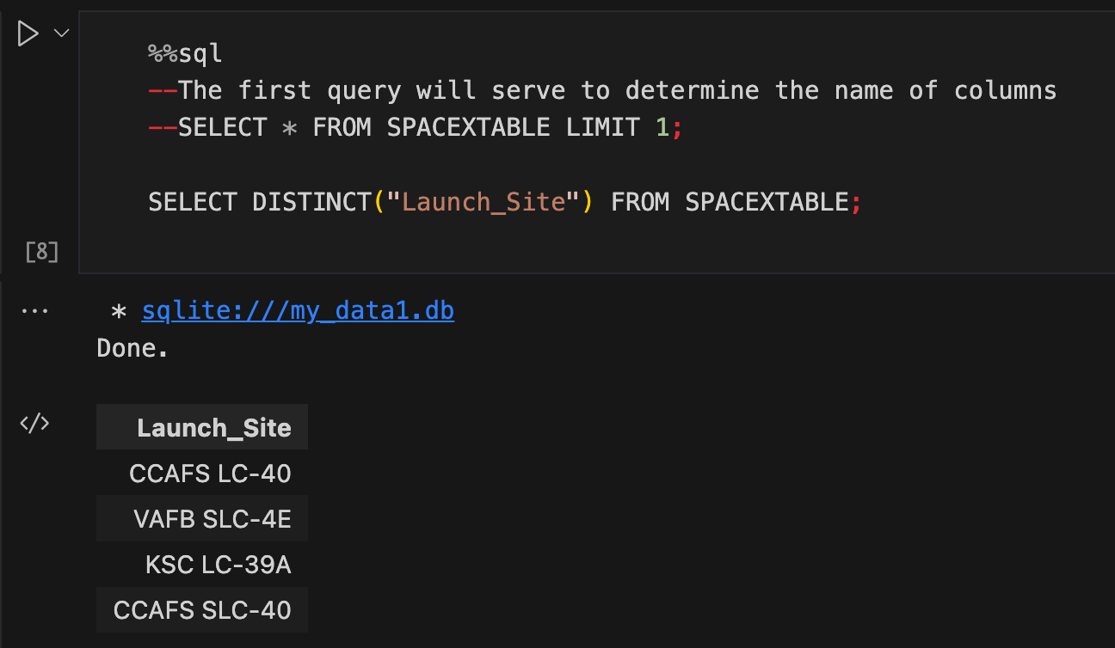
Extracting Launch Sites Name’s

Slide 21
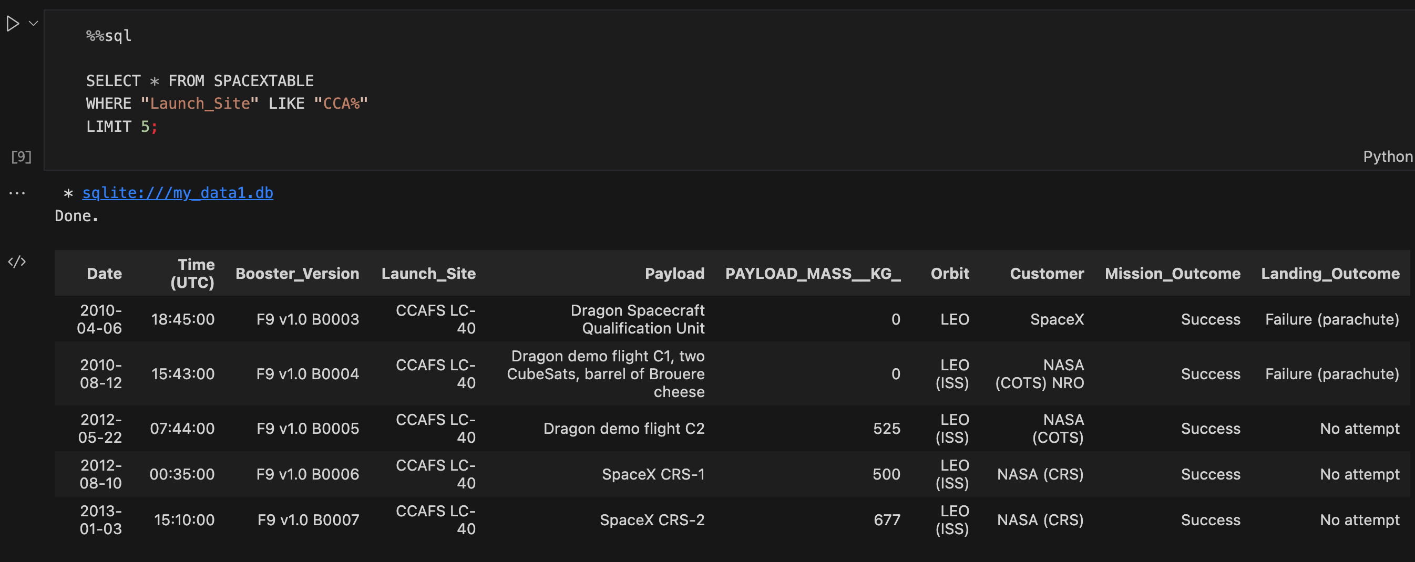
Launch Sites Names beginning with CAA

Slide 22
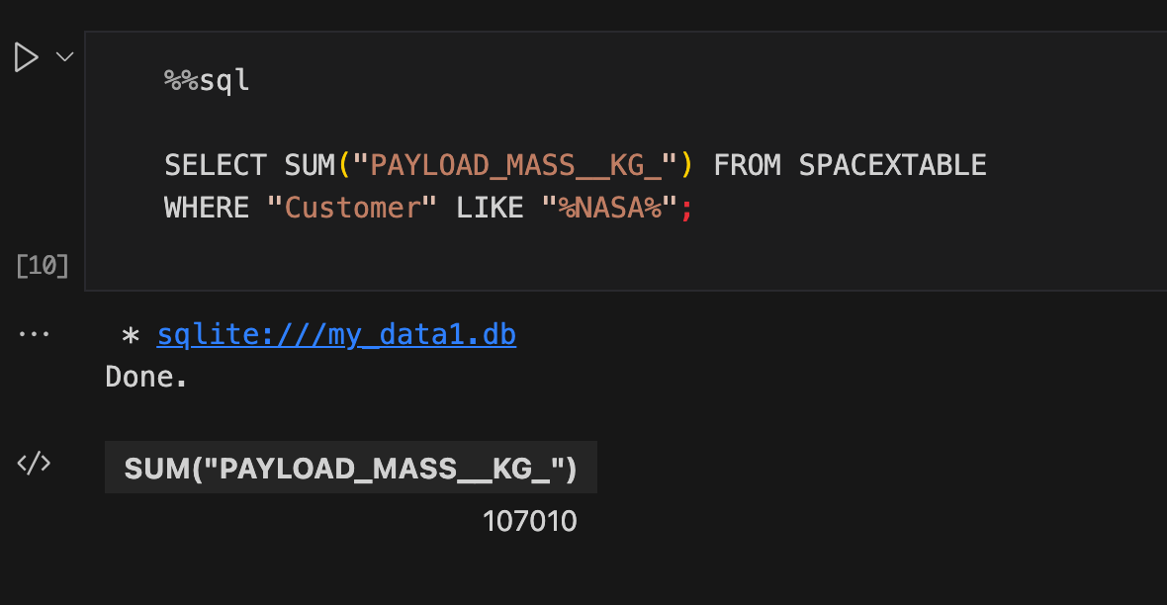
Total Payload Mass carried NASA’s boosters

Slide 23
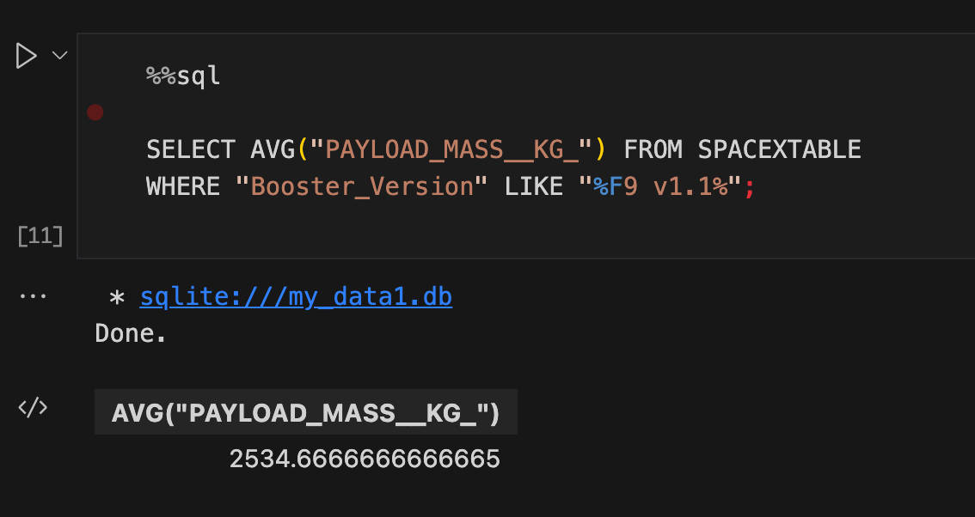
Average Payload Mass carried by booster F9 V1.1

Slide 24
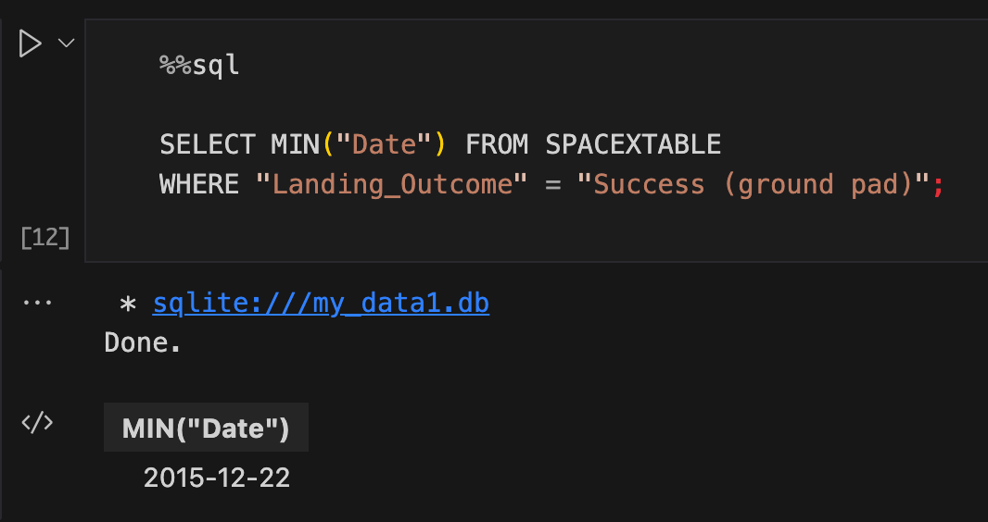
Date of the first successful landing in ground pad

Slide 25
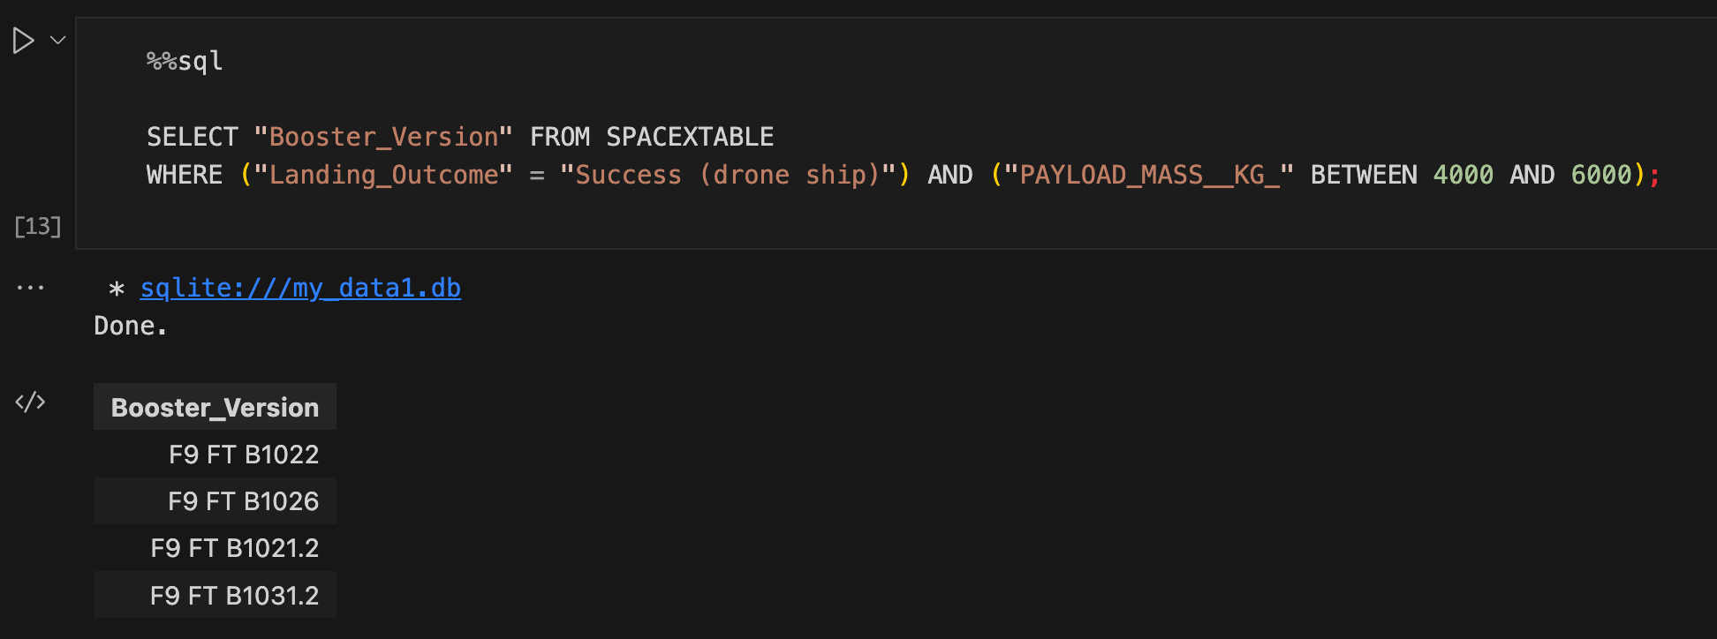
Names of the boosters which have success in drone ship and have payload mass greater than 4000 but less than 6000

Slide 26
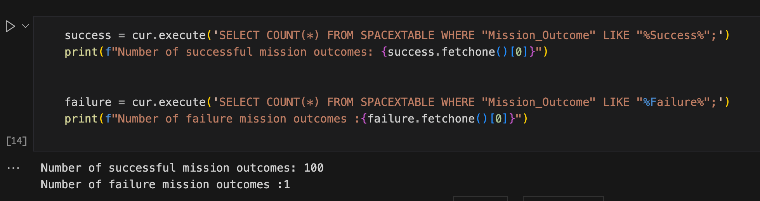
Total number of successful and failure mission outcomes

Slide 27
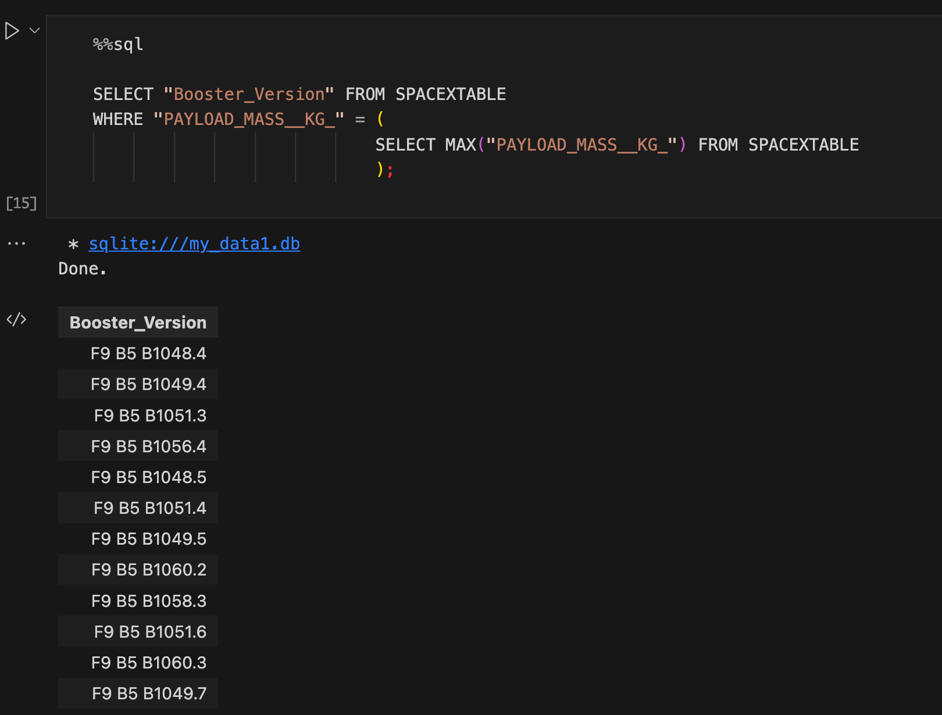
Names of the booster_versions which have carried the maximum Payload Mass

Slide 28
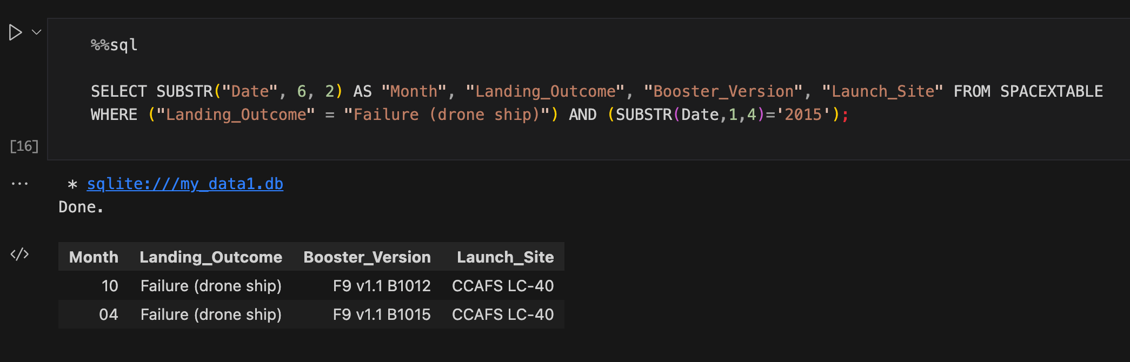
The records displaying the month names, failure landing_outcomes in drone ship ,booster versions, launch_site for the months in year 2015.

Slide 29
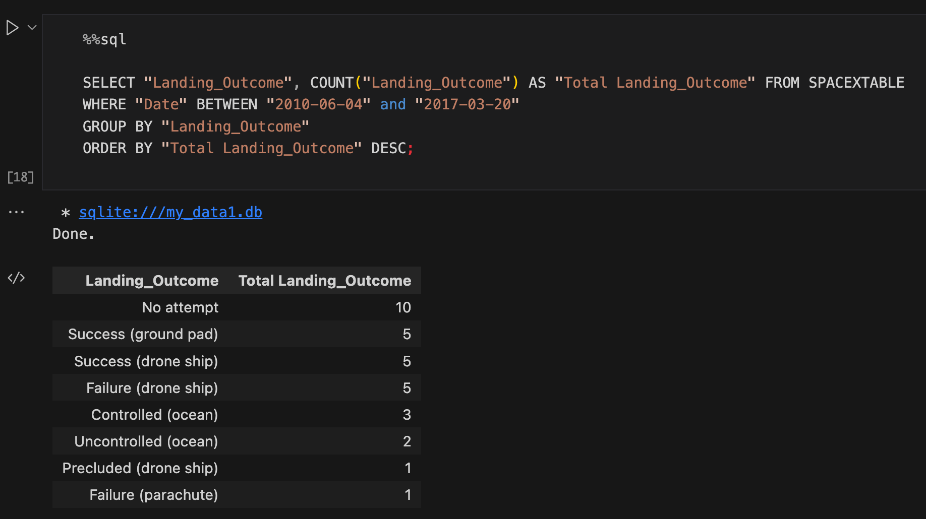
Ranking the count of landing outcomes between the date 2010-06-04 and 2017-03-20

Slide 30
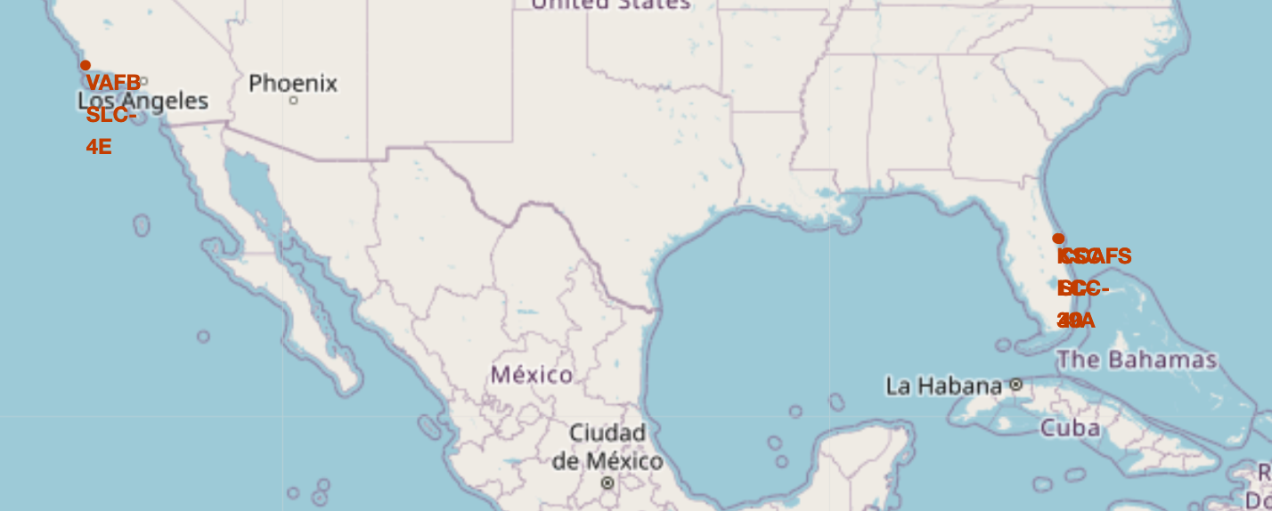
Marking the 3 Launch Sites on the Map

Slide 31
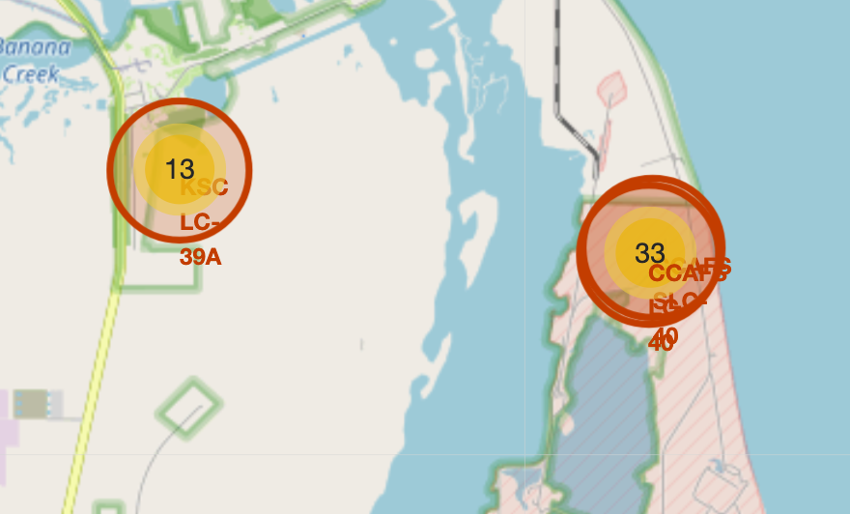
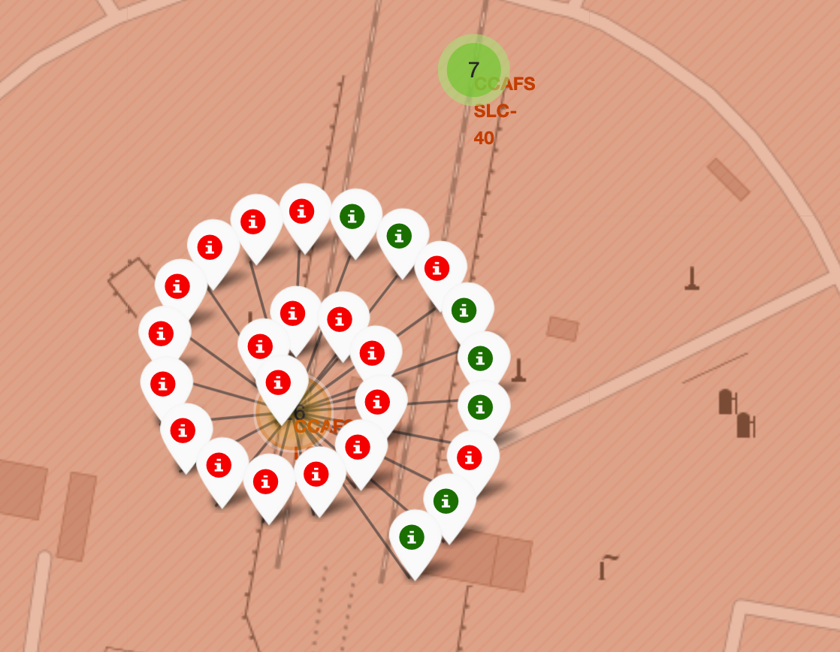
Marking All Flights using MarkerCluster

Slide 32
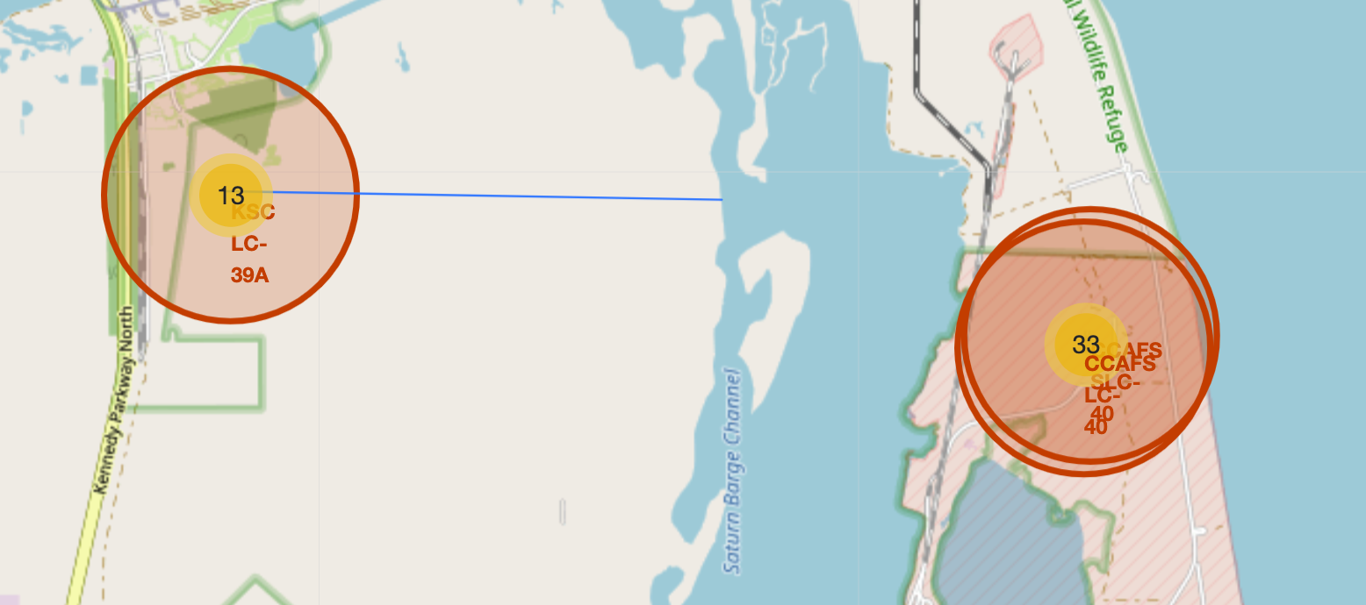
Finding the closest coastline to KSC station

Slide 33
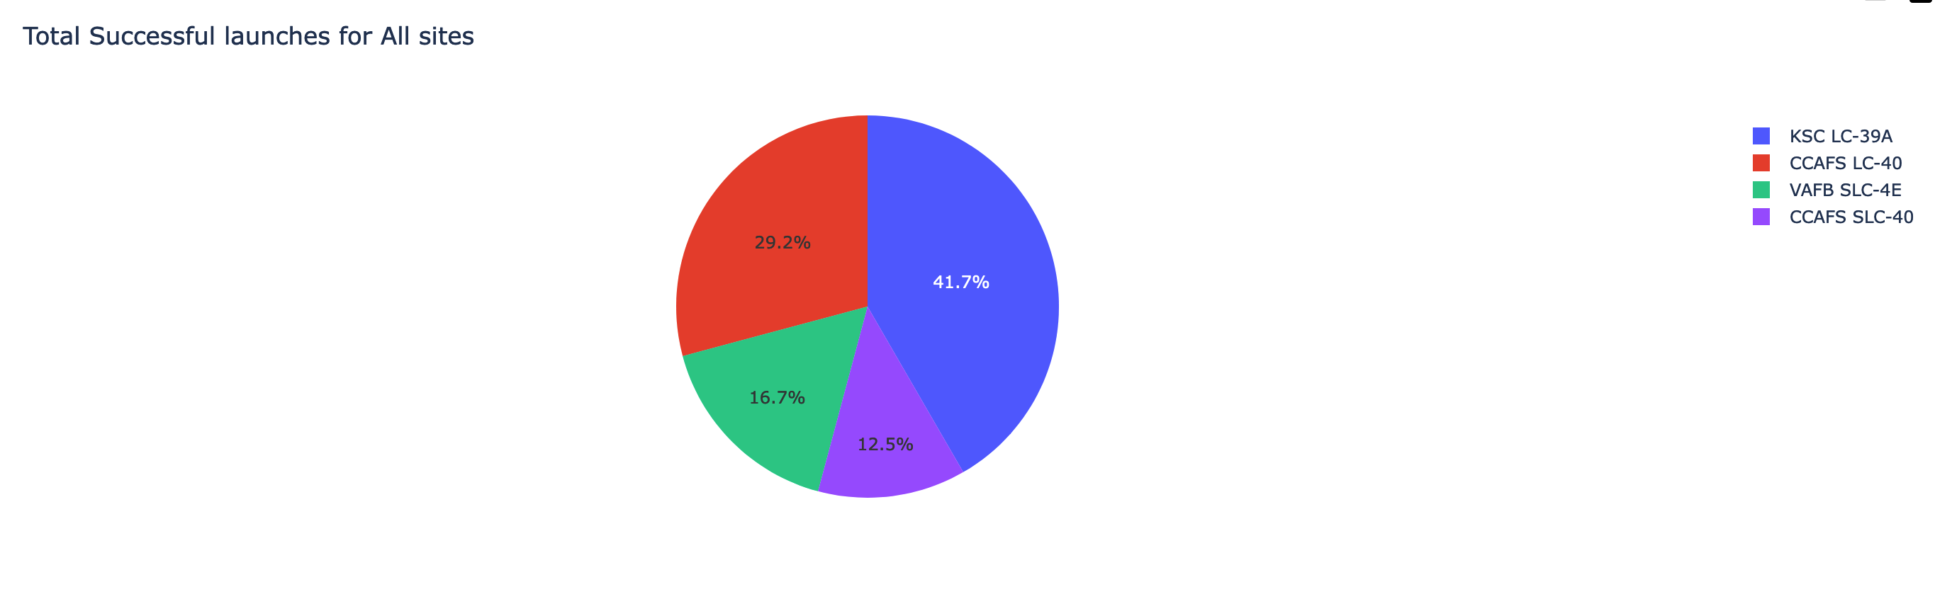
Total Successful launches for All sites
KSC LC-39A has the heighest number of successful flights

Slide 34
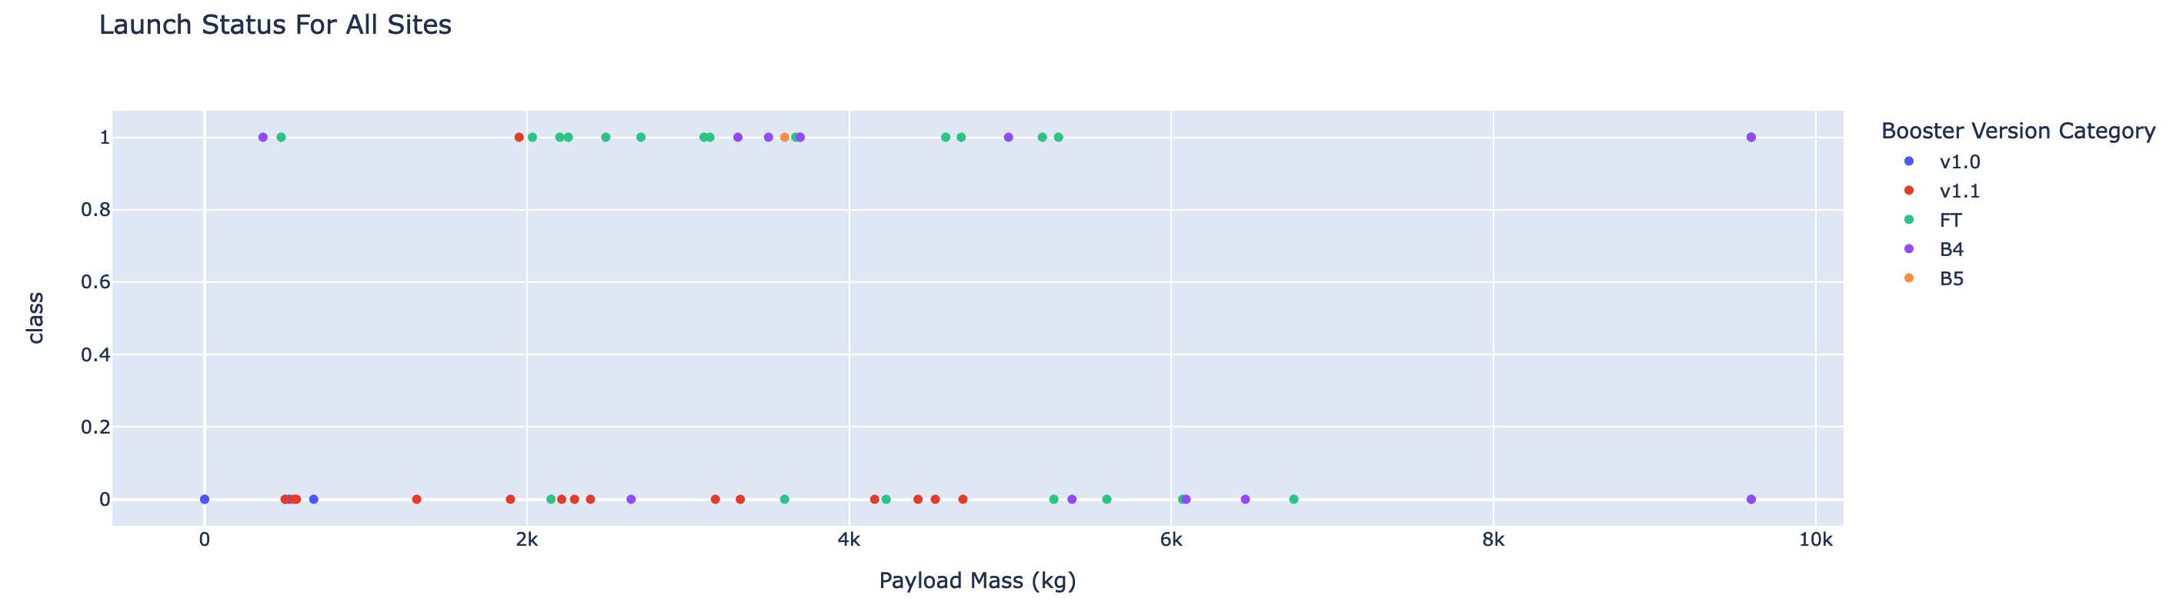
Total Successful launches for All sites
It seems that there is no correlation between the payload mass and the status of the flight

Slide 35
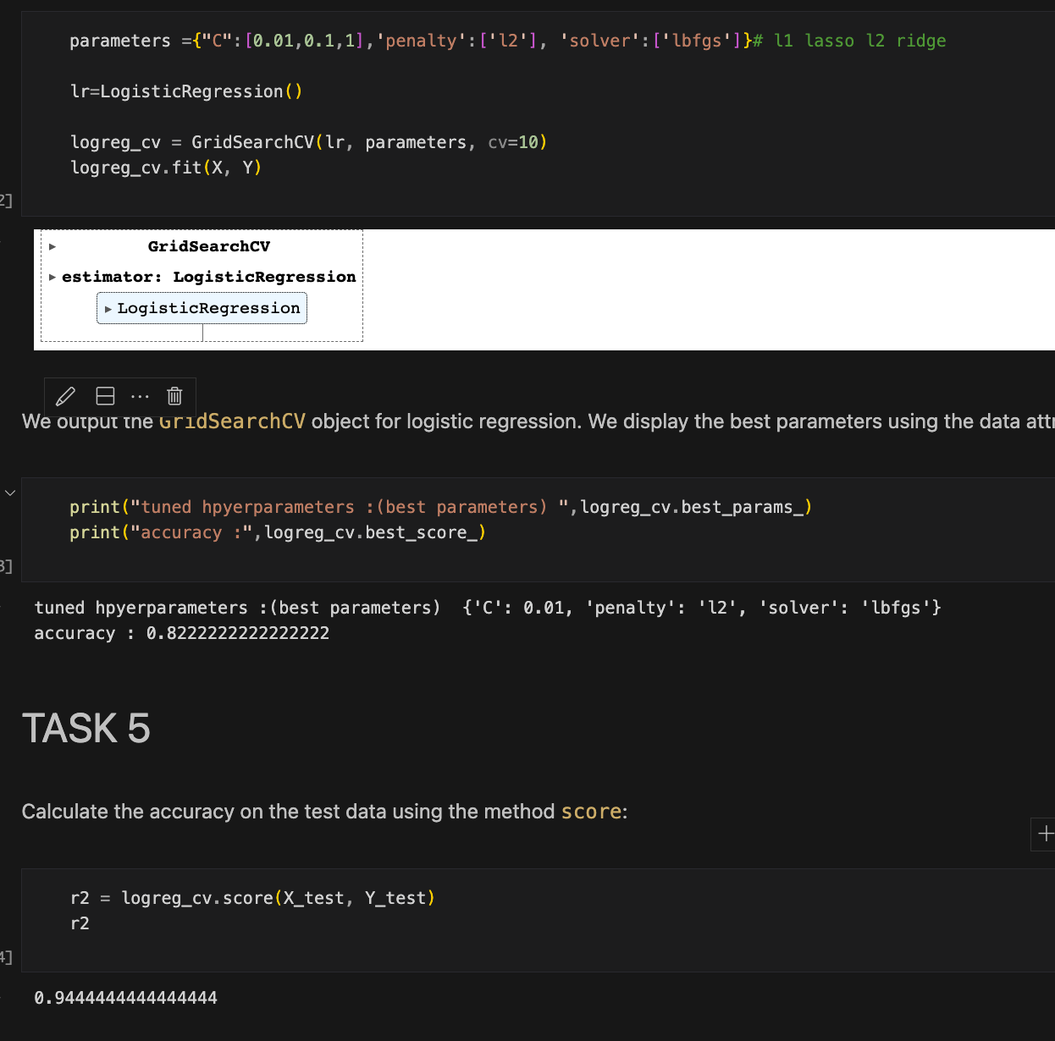
Creating a logistic Regression Model
It turns out that this model is the best model, since it has the highest R2 score on the test Data

Slide 36
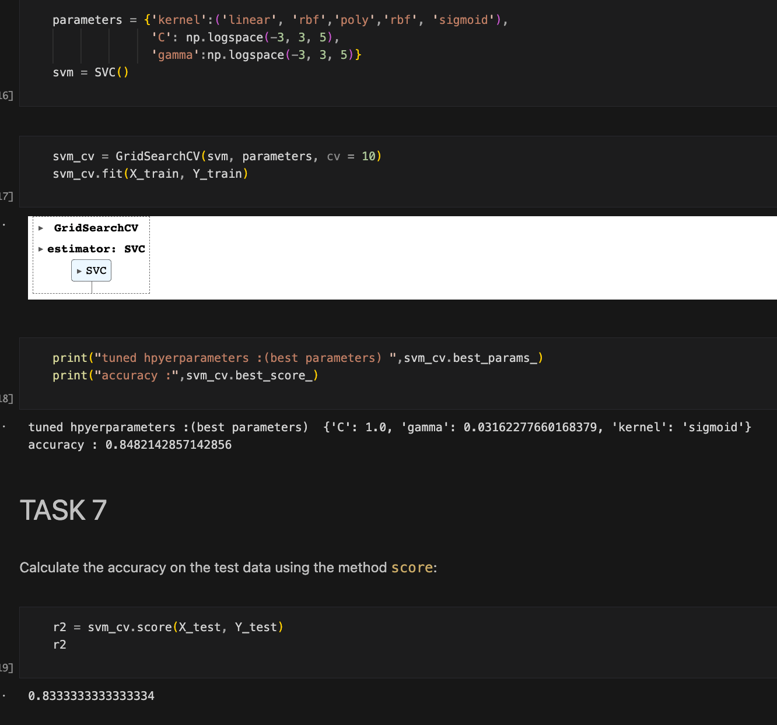

Creating a SVM Model
This model is suitable, it has a good R2 score.

Slide 37
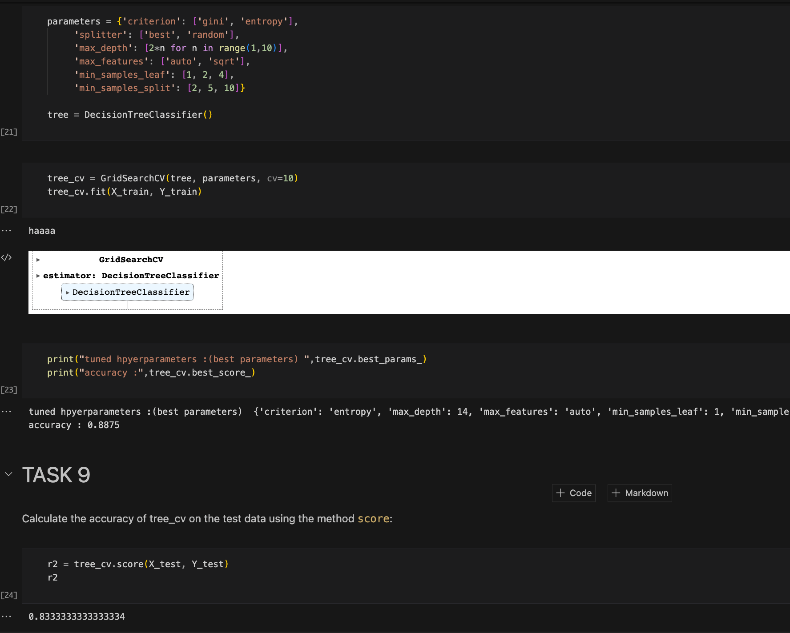
Creating a Decision Tree Model
This model is suitable, it has a good R2 score.

Slide 38
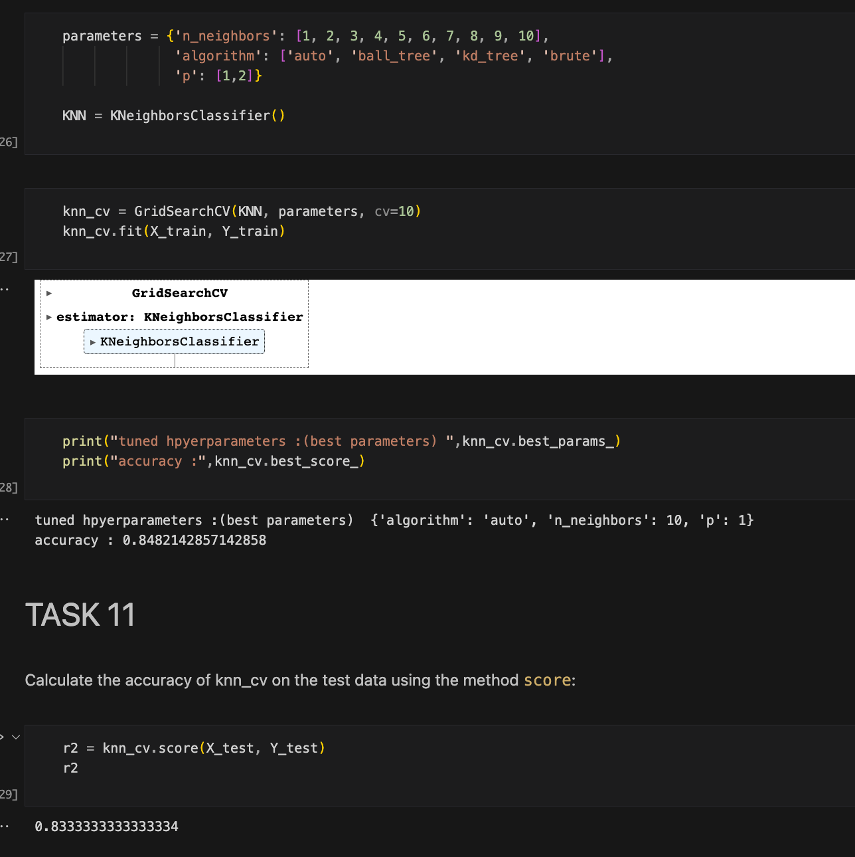
Creating a KNN Model
This model is suitable, it has a good R2 score.

Slide 39
Conclusions
We can conclude that:
The larger the flight amount at a launch site, the greater the success rate at a launch site because of the gain of experience
Orbits ES-L1, GEO, HEO, SSO, VLEO had the most success rate.
KSC LC-39A had the most successful launches of any sites.
The logistic regression model classifier is the best machine learning algorithm for this task.

Slide 40
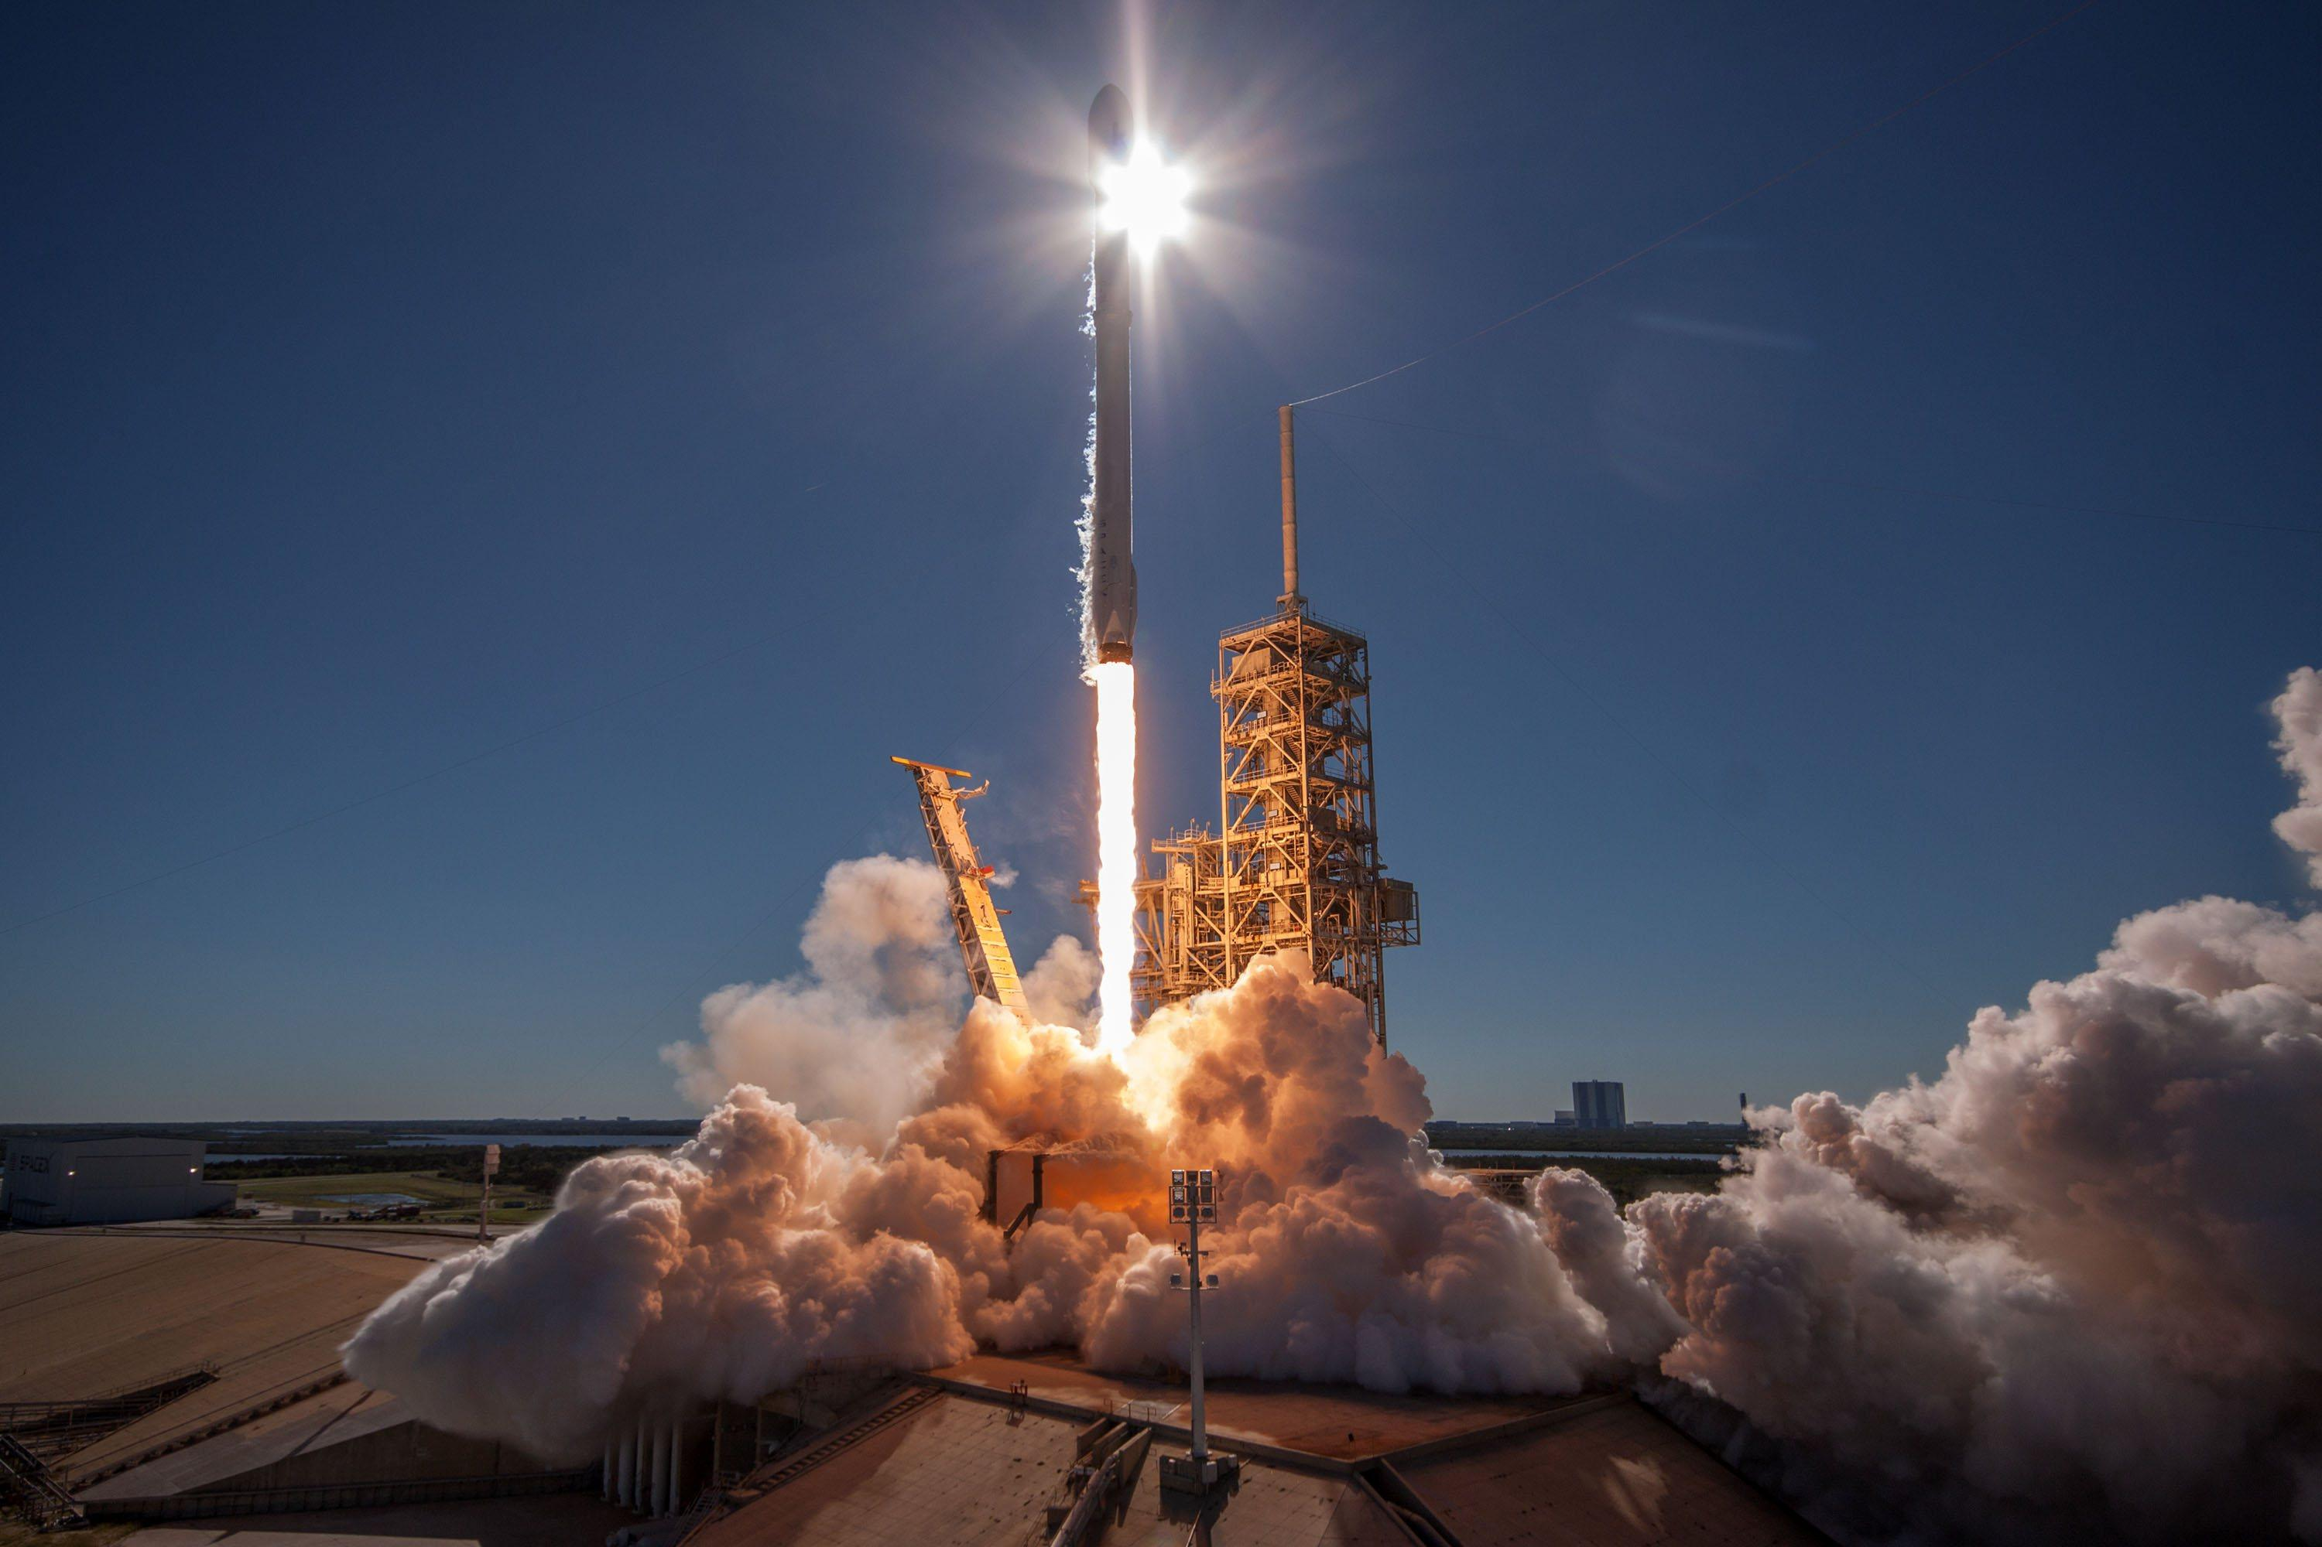
Thanks
Github Link : https://github.com/AbdoNiceman/IBM_certificate/tree/95d09593cf69e74dddef61cad857824091bb83c5/Applied%20Data%20Science%20Capstone

